Slide 1
Stroke Prediction
Shraddha P Jain
20-PBD-002
Notes:
This dataset is used to predict whether a patient is likely to get stroke based on the input parameters like gender, age, various diseases, and smoking status. Each row in the data provides relavant information about the patient.

Slide 2
Objective
According to the World Health Organization (WHO) stroke is the 2nd leading cause of death globally, responsible for approximately 11% of total deaths.
The objective of this modelling is to predict whether a patient is likely to get stroke based on the input parameters like gender, age, various diseases, and smoking status, etc.

Slide 3
Dataset
1) id: unique identifier 2) gender: "Male", "Female" or "Other" 3) age: age of the patient 4) hypertension: 0 if the patient doesn't have hypertension, 1 if the patient has hypertension 5) heart_disease: 0 if the patient doesn't have any heart diseases, 1 if the patient has a heart disease 6) ever_married: "No" or "Yes" 7) work_type: "children", "Govt_jov", "Never_worked", "Private" or "Self-employed"

Slide 4
8) Residence_type: "Rural" or "Urban" 9) avg_glucose_level: average glucose level in blood 10) bmi: body mass index 11) smoking_status: "formerly smoked", "never smoked", "smokes" or "Unknown"* 12) stroke: 1 if the patient had a stroke or 0 if not

Slide 5
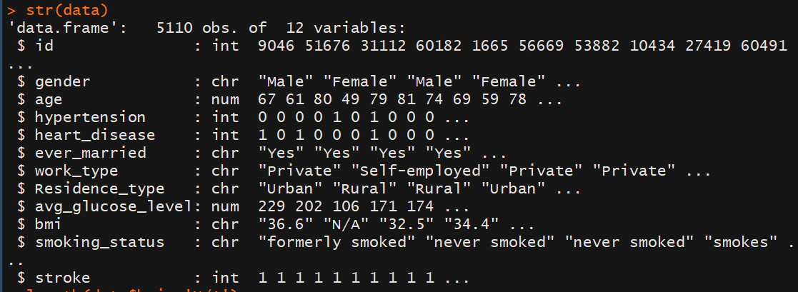
Data Preprocessing
Notes:
Drop the id column
Bmi is being read as character due to NA’s. change these NA’s as NA of R, then convert the column to numberic
Change the fields chr to factors
Change hypertension, heart_disease, stroke to factors

Slide 6
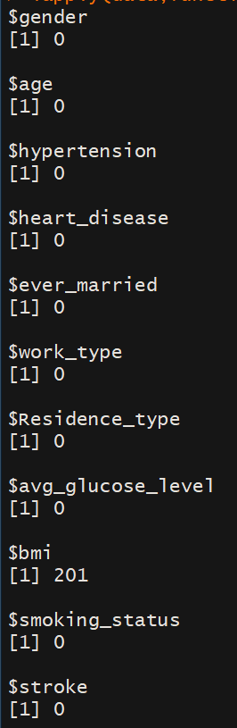
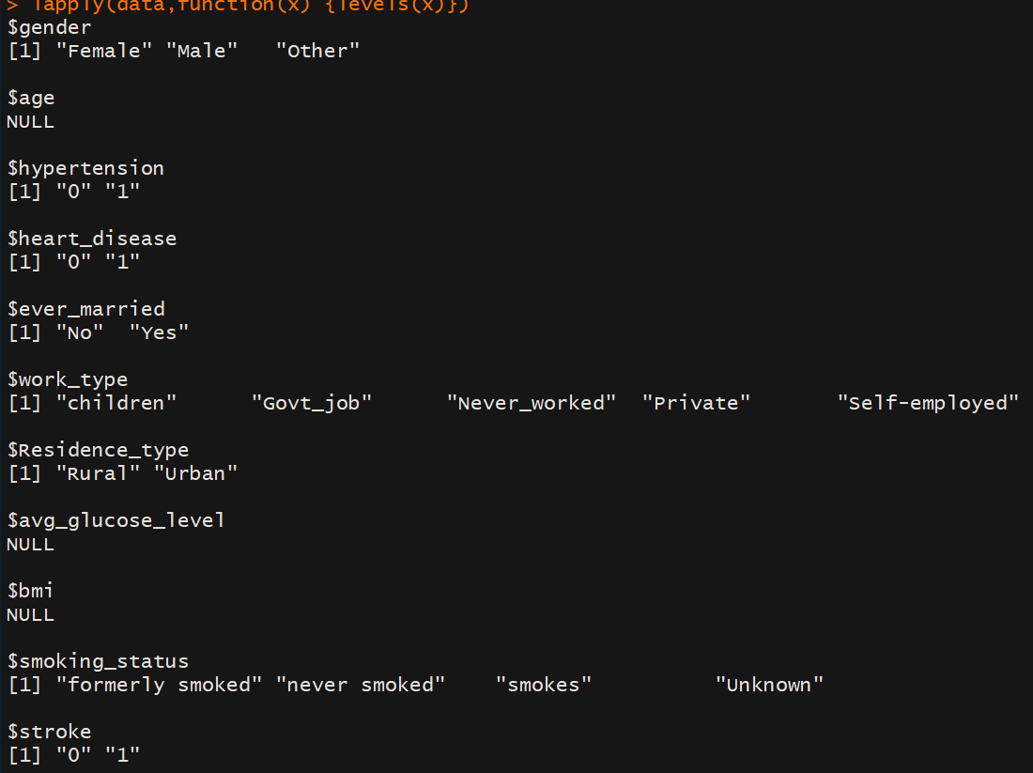
Checking for NA’s and Levels
Notes:
We have 201 na’s in bmi. And none in other columns. Although smoking_status has ‘unknown’ level, which is same as NA, but we can consider it to be another level.

Slide 7
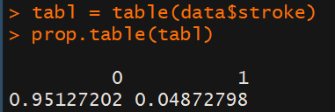
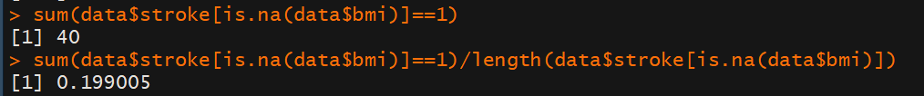
Dealing with NA’s
Imputation using MICE
Notes:
We have a dataset of 5110 rows. It seems like a convenient option to just drop the 201 rows having bmi as NA’s. But on further analysis, what I’ve found is in the whole data, 5% of the patients have had a stroke, but out of the patients with unknown bmi, 20% of them have had a stroke attack. This might mean that this missingness is Not Completely At Random. I will try two approach to handle this missingness -> 1, Imputation using MICE, 2. Create classes of the bmi, and make it into a factor, with NA’s being one of the level.

Slide 8
Exploratory data Analysis
For gender ‘Other’, there is only 1 patient who has not had any attack of stroke.
For the work_type, due to not-enough samples, we have only 22 patients who have never worked, and all of them did not have an attack of stroke.
Notes:
1. I am not removing this variable as of now./// Removing it

Slide 9
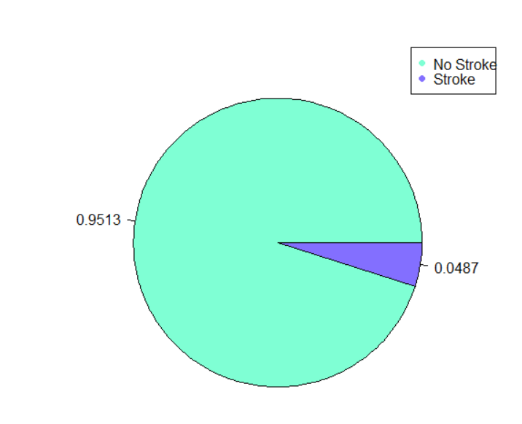
Stroke
Notes:
This indicates we might need to over/under sample

Slide 10
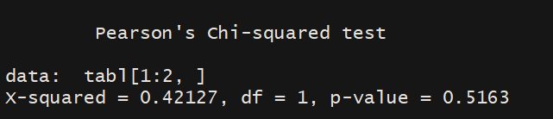
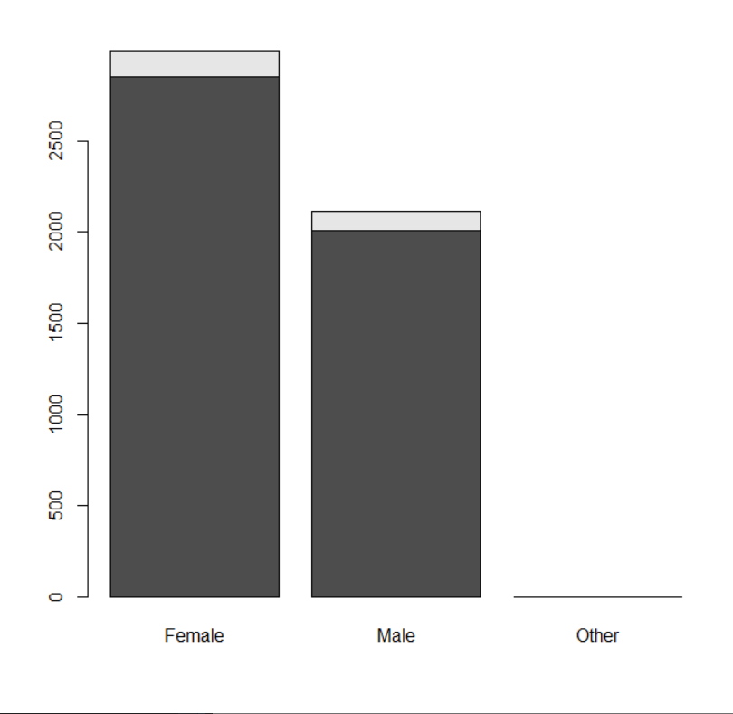
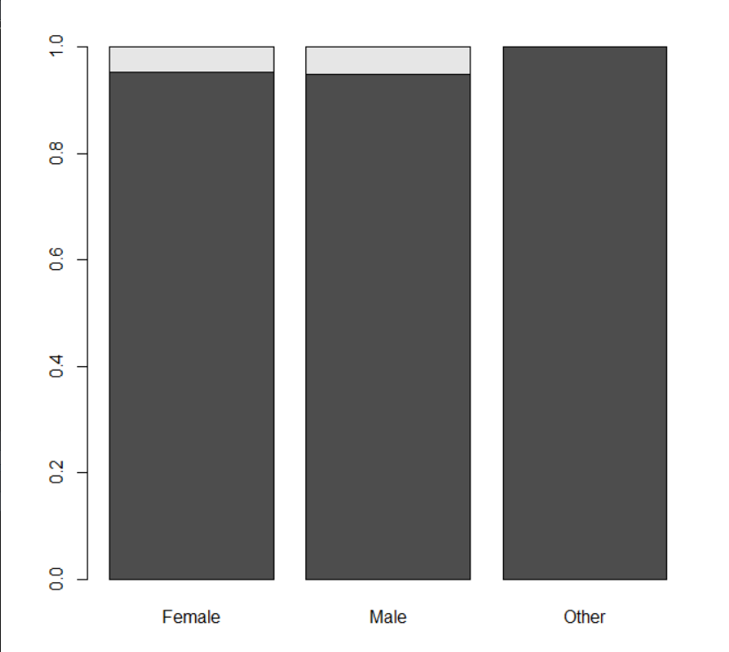
Gender
Notes:
So, around 60% of the samples are of females, while around 40% were males. There was only one sample in the category Other. Also, 4.7% of all females had stroke, while 5.1% of males. This difference does not seem significant. Doing a chi-square test of independence b/w gender and stroke gives a p value of 0.5163, meaning that we can assume stroke to be independent of gender. For this, I had removed the ‘Other’ datapoint

Slide 11
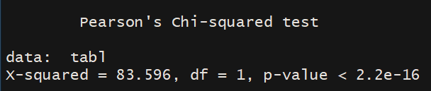
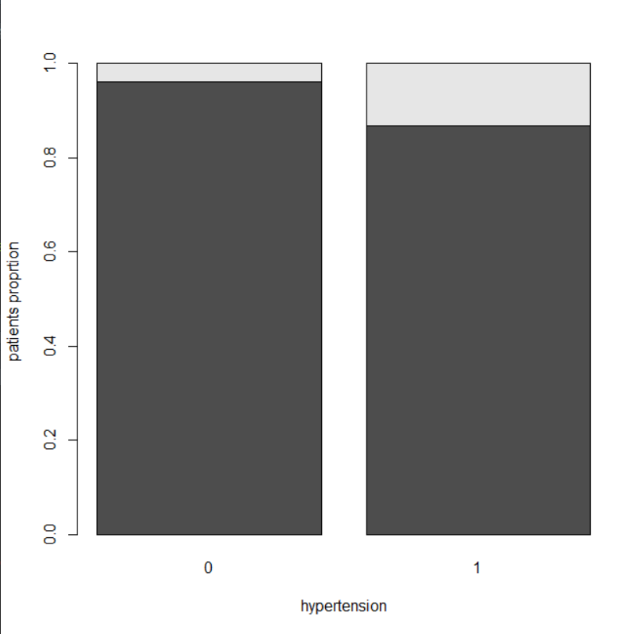
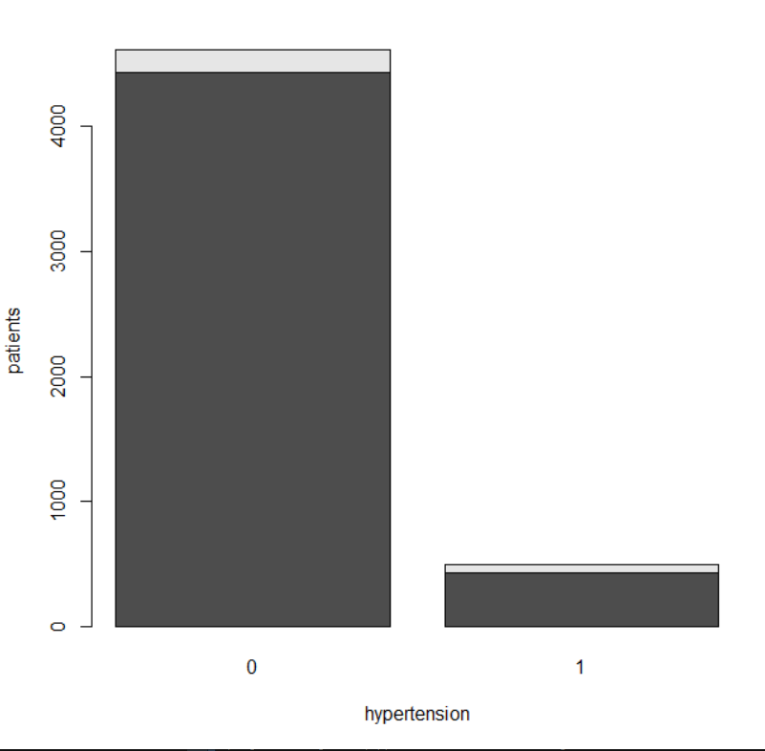
Hypertension
Notes:
Around 10% of the people have hypertension. Also, only 4% of people who do not have hypertension had stroke, as compared to 13% of the people who were tested positive for hypertension. As we can see, stroke may not be independent of hypertension

Slide 12
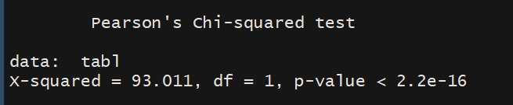
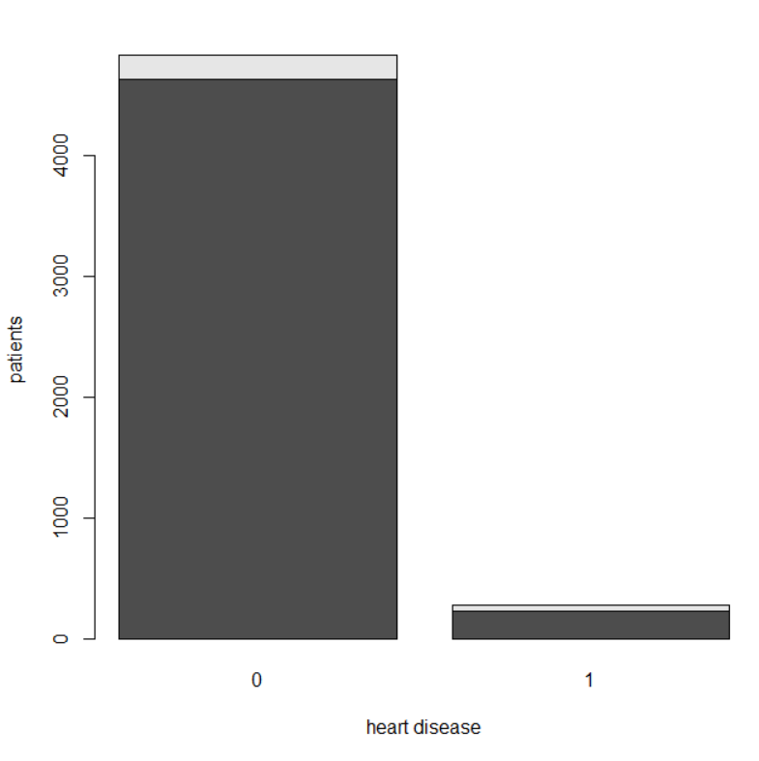
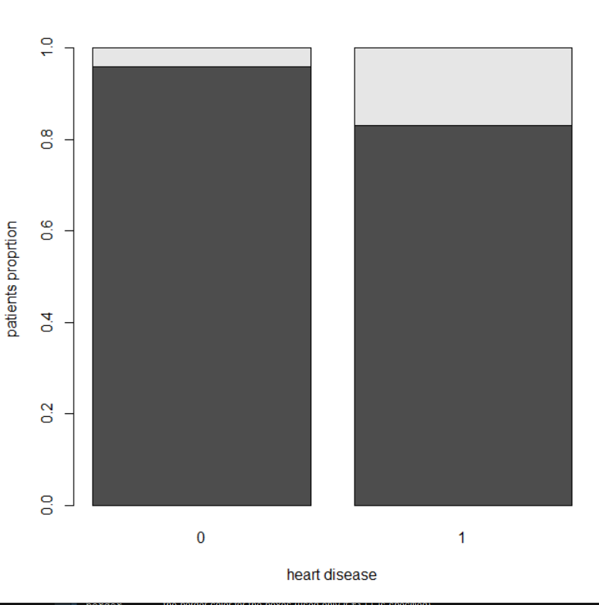
Heart Disease
Notes:
5.4% of the people have a heart disease. 17% of people who have hear disease have had a stroke, as compared to 4% of people who do not have heart disease

Slide 13
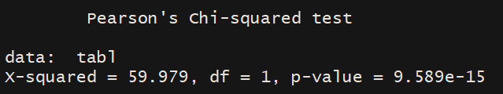
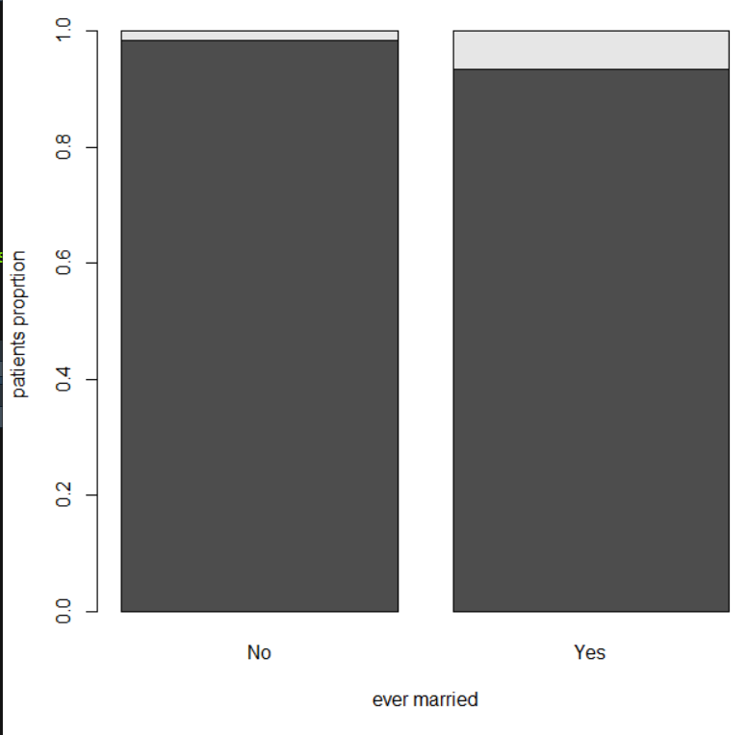
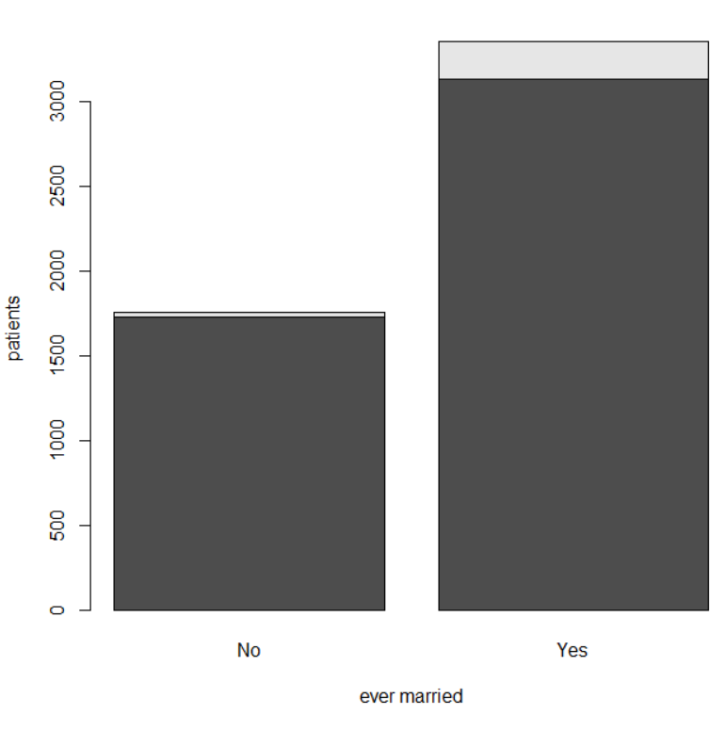
Ever_married
Notes:
65% of the people were married. 6% of people who had married had had a stroke, while only 1% of people otherwise. Although this seems like a significant difference, One thing to note here is that as we’ll see later, younger people have very less chance of stroke, as compared to older ones. Also, younger people are less likely to be married (we have childeren also in our dataset, and they would of course, never have married)

Slide 14
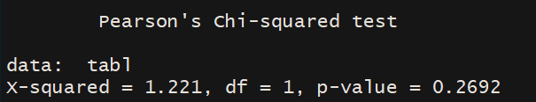
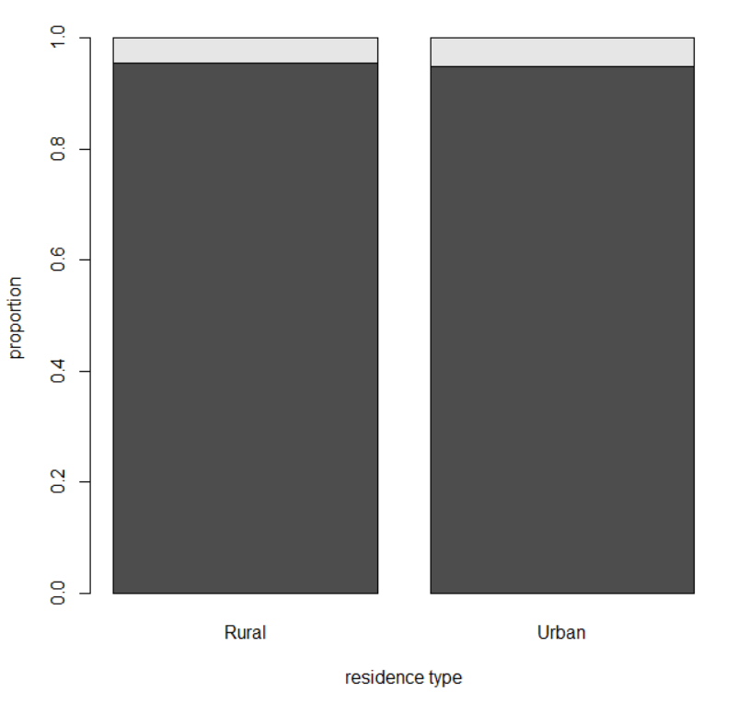
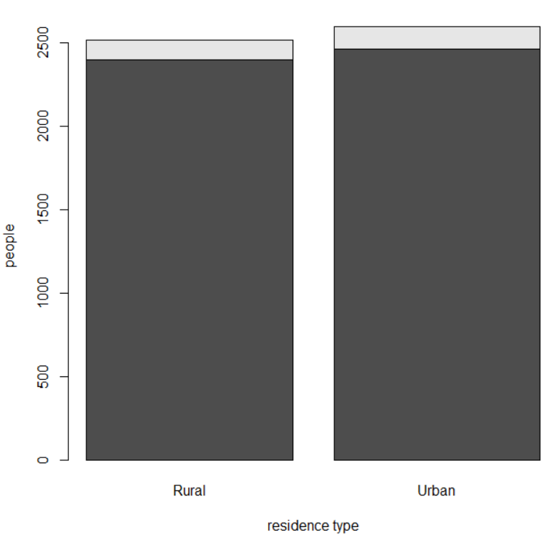
Residence Type
Notes:
We have around 49% people from rural background, while 51% from urban residance type. 4.5% people from the rural area had had stroke as compared to 5.2% of people from urban background.

Slide 15
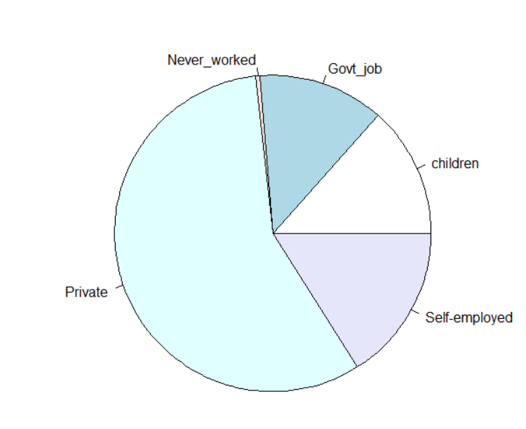
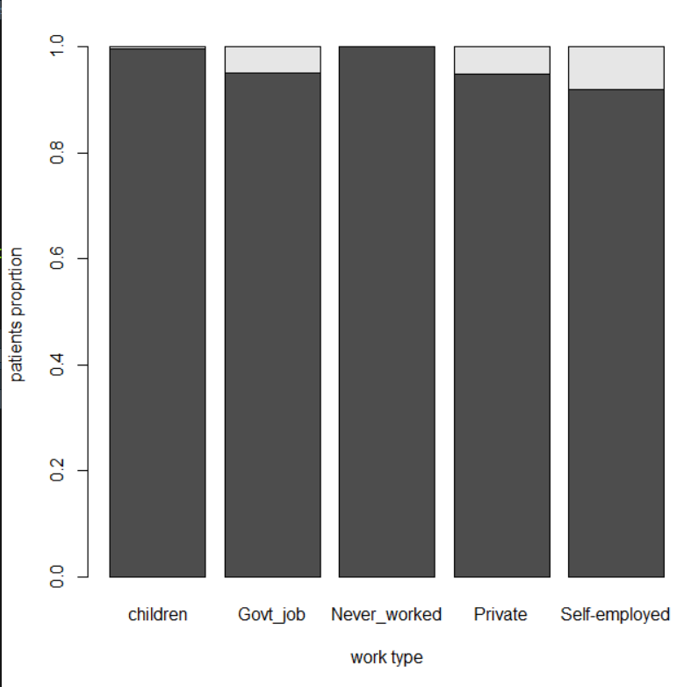
Work Type

Slide 16
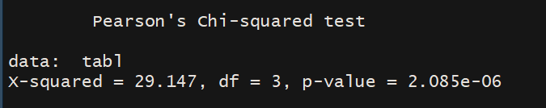
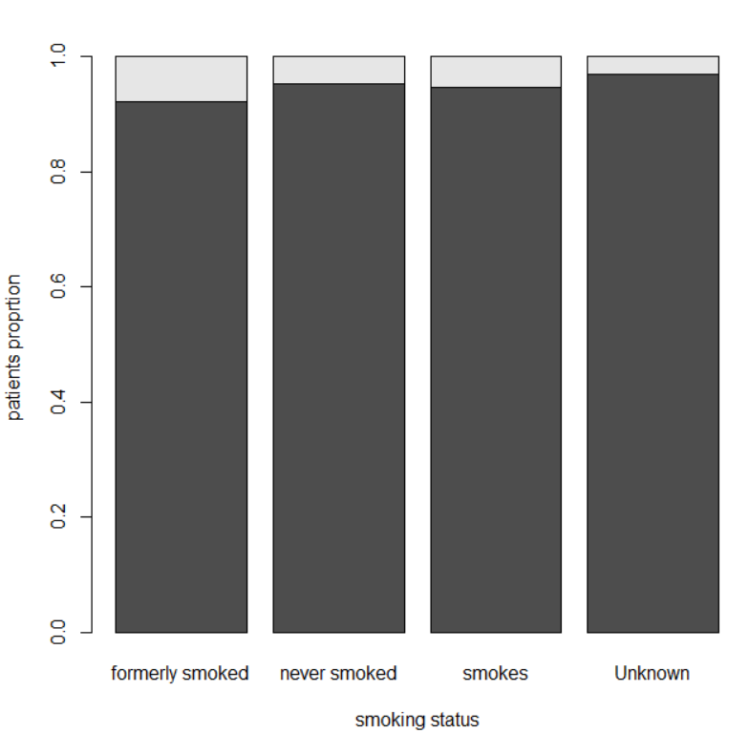
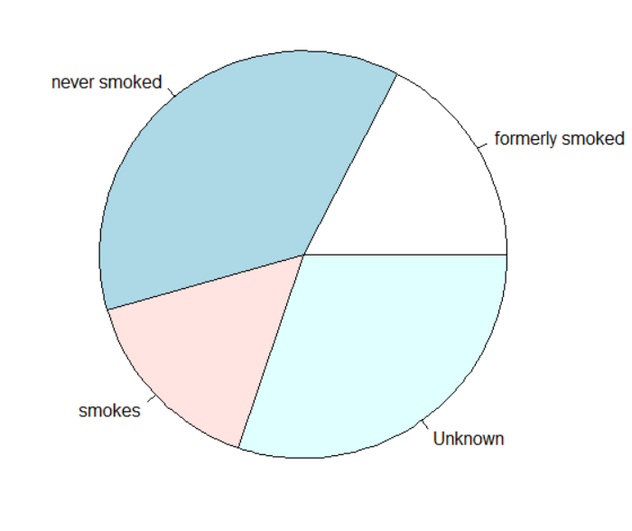
Smoking Status

Slide 17
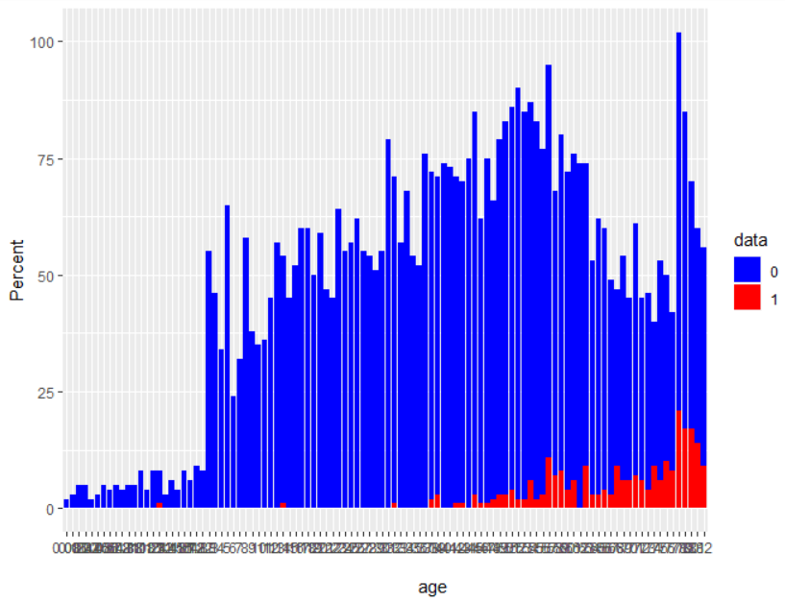
Age

Slide 18
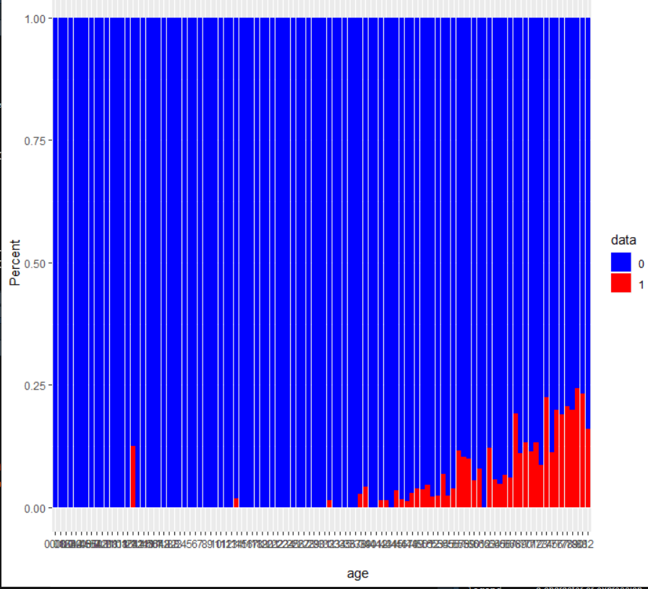

Slide 19
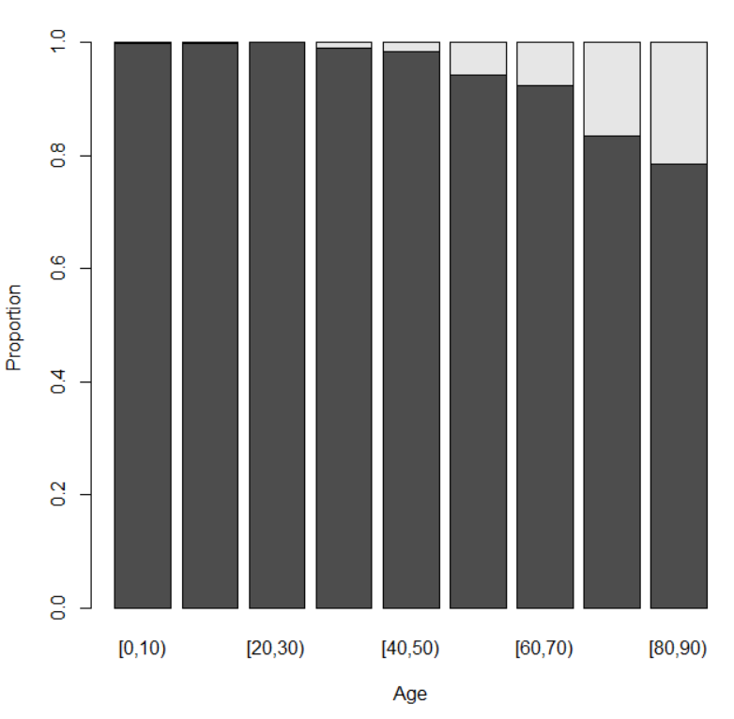
Notes:
Creating bins out of age class

Slide 20
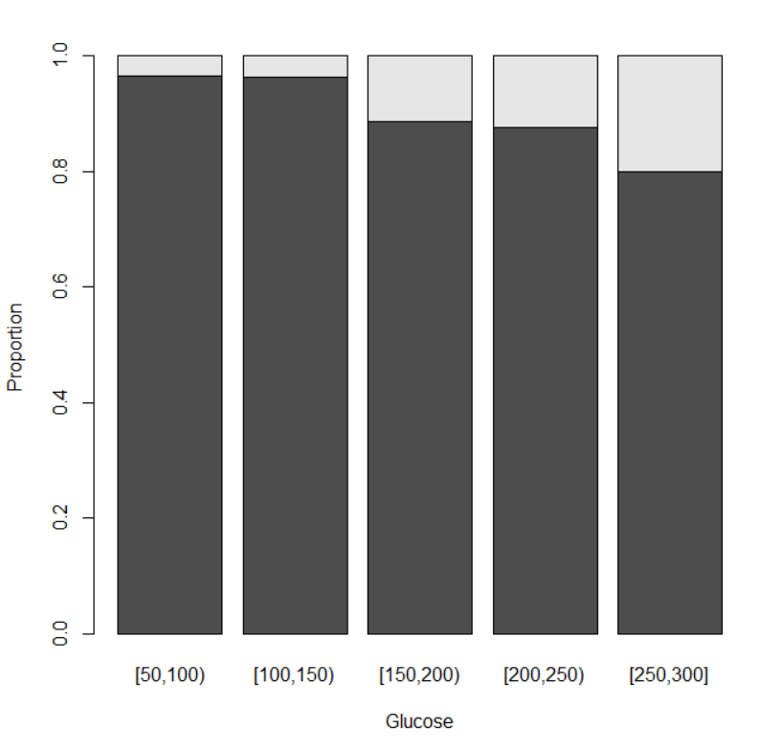
Glucose levels binned

Slide 21
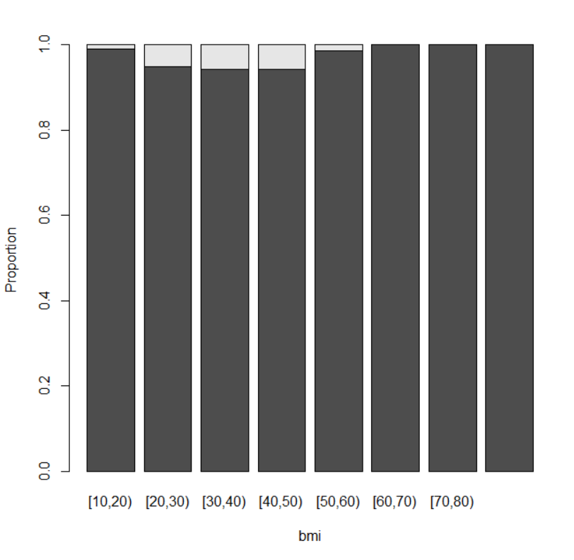
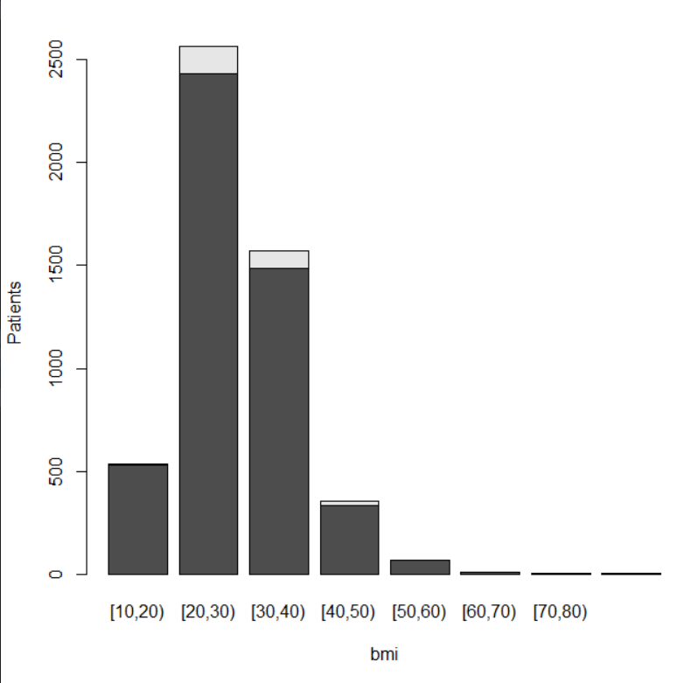
BMI binned

Slide 22
Conclusion
Hypertension, heartdisease, and ever_married, worktype, age, glucose level, bmi,smoking status might be important variables for predicting

Slide 23
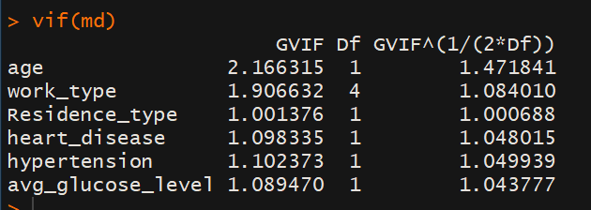
Multicollinearity and VIF
Checked for multicollinearity of bmi on age, worktype, residence type, heart disease, hypertension, and glucose level. No severe multicollinearity was found

Slide 24
Similarly, checking for multicollinearity between glucose and other variables, no severe multicollinearity was found
Same can be said for hypertension, and age

Slide 25
Modelling - Preprocessing
Encoding the dummy variables of worktype, smoking status, and gender
There are some outliers in bmi, and average glucose status. Not removing any datapoint as of now
Doing a train-test split

Slide 26
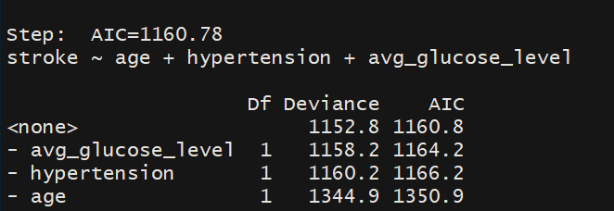
Logistic Regression
After encoding the variables, had 15 variables. On performing a logistic regression, although the model was significant overall, most of the variables used were insignificant.
So, I did a stepwise logistic regression.

Slide 27
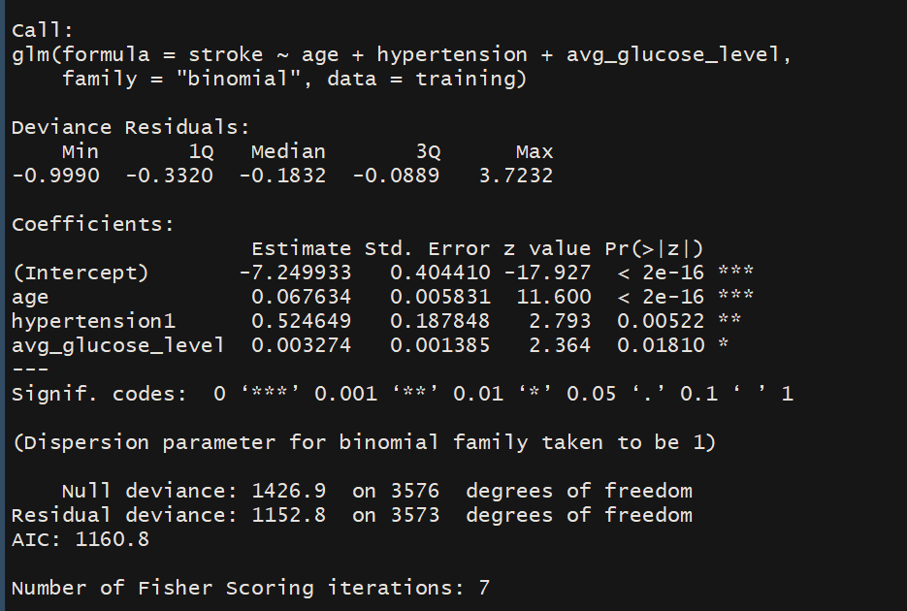
Notes:
The model is overall significant, and all the variables are also significant.
Everything looks fine here, but…

Slide 28
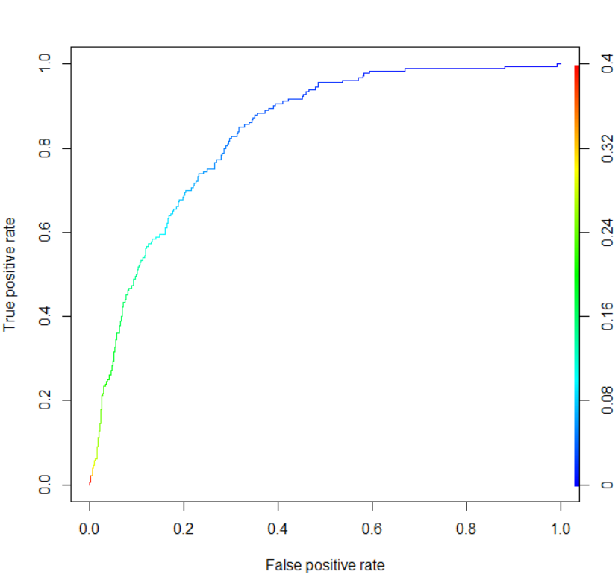
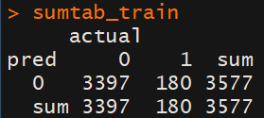
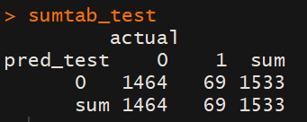
Notes:
For both training, and testing data, it’s predicting 0 in all the cases. Note that we are using 0.5 as the cut off probability. Specifictiy is literally 0. I experimented with the cutoff probabilitties.

Slide 29
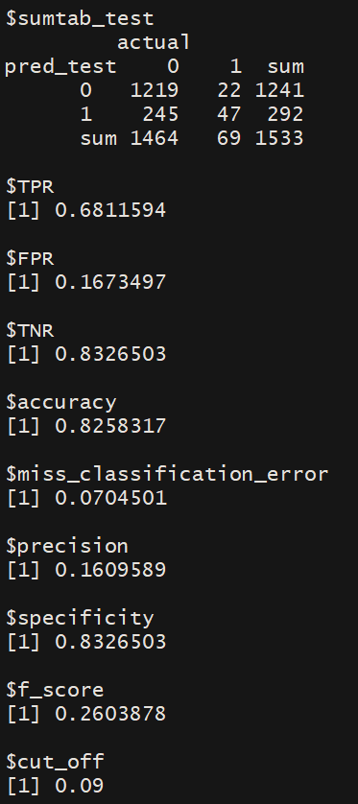
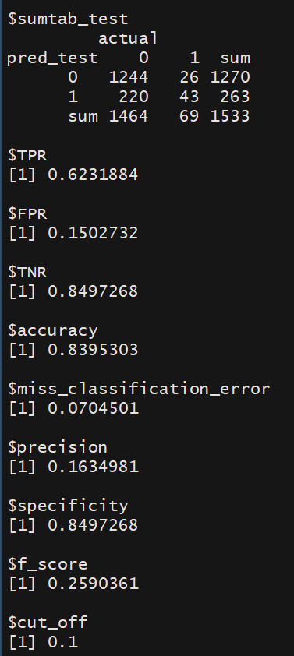
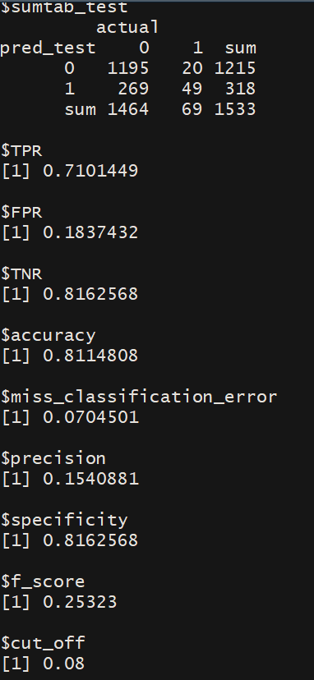

Slide 30
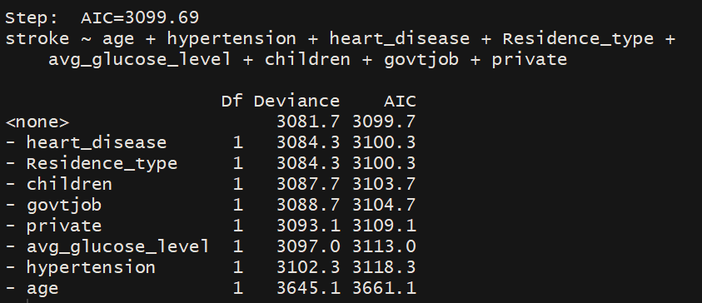
Oversampling
Used ROSE package to oversample the data because of class imbalance
After oversampling, the proportion of people who had stoke increased to around 19%
Did stepwise regression on this oversampled data.
Notes:
This time, more variabled have been included in the model

Slide 31
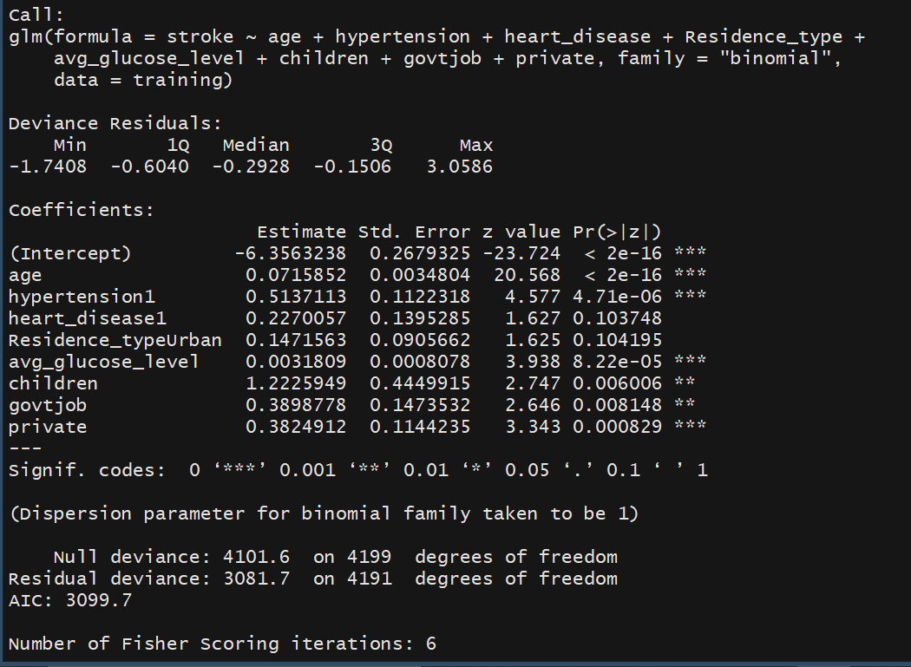

Slide 32
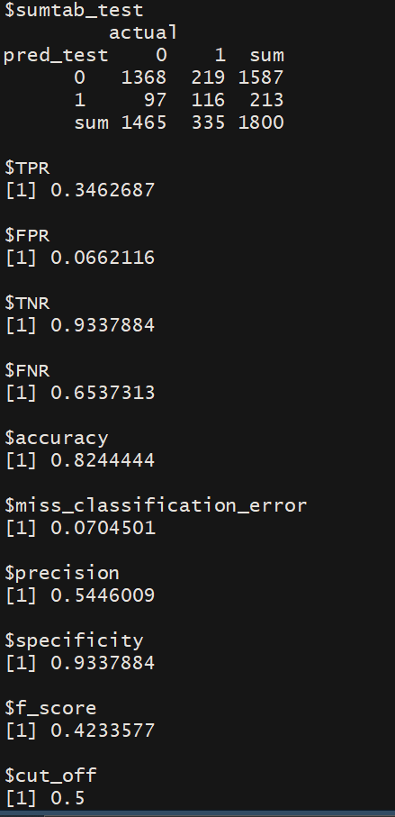
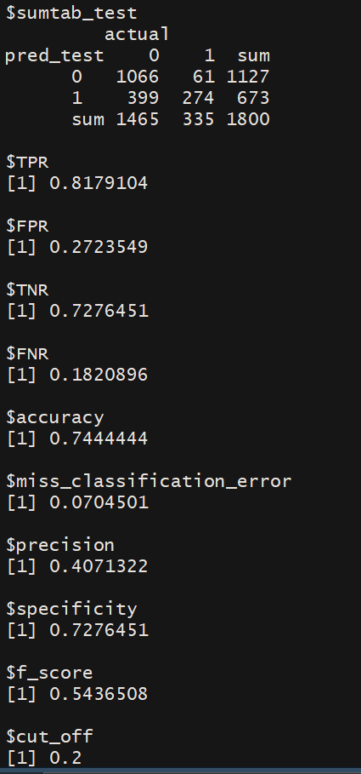
Notes:
All the metrics have improved

Slide 33

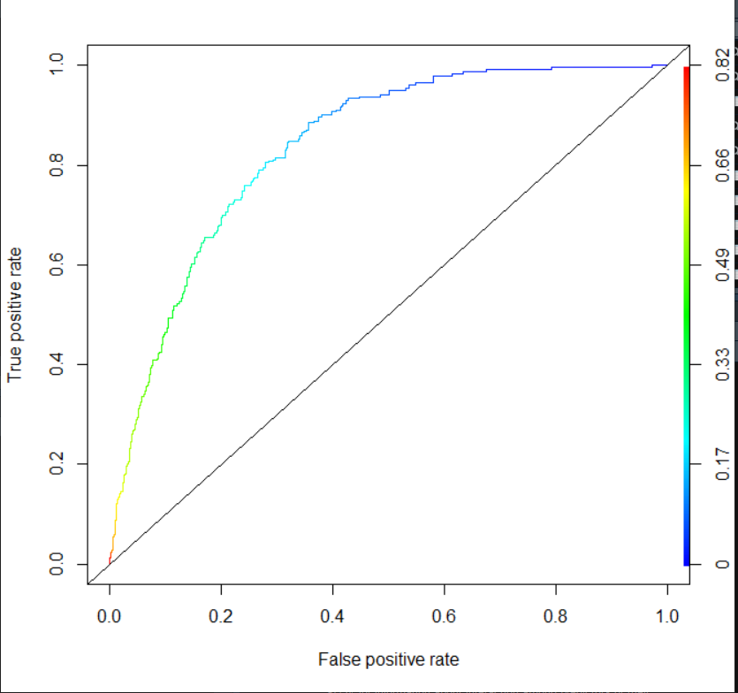
Roc curve, and AUC
Notes:
I had also experimented with different cut off values of probabilities, specificity, accuracy, precision were all best at around 0.5 cut off and decreased as we decreased the cutoff values, while sensitivity with decrease in cutoff values. F_score was best cutoff 0.2 but was still around 0.54 only.

Slide 34
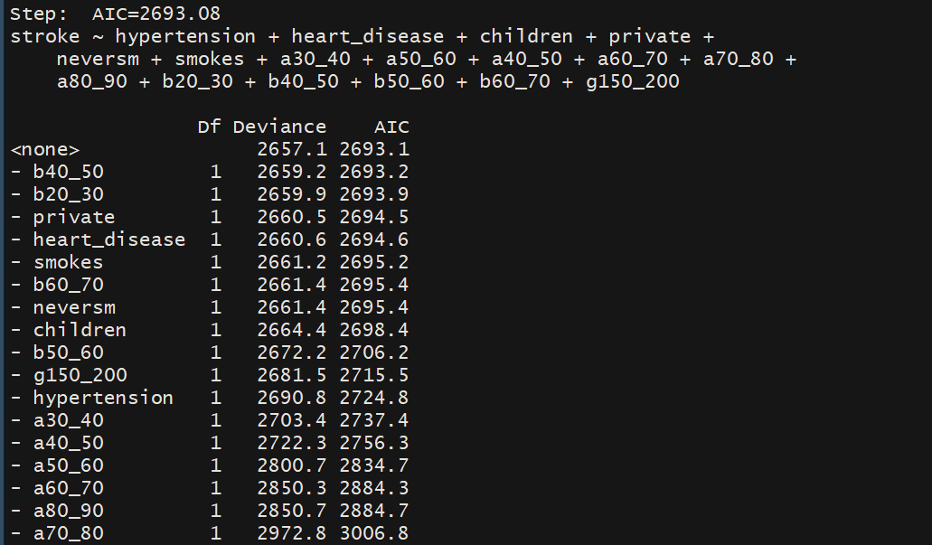
Logisitic Regression with binned numerical variables

Slide 35
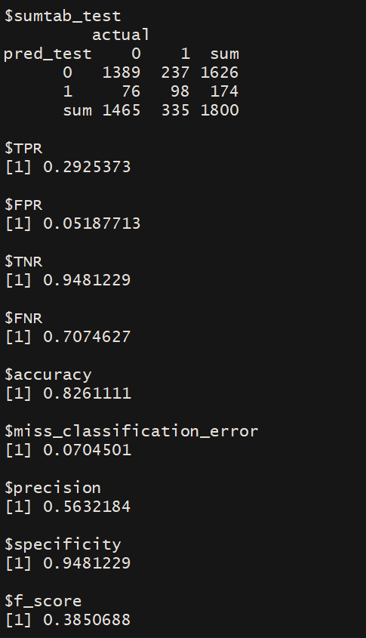

Slide 36
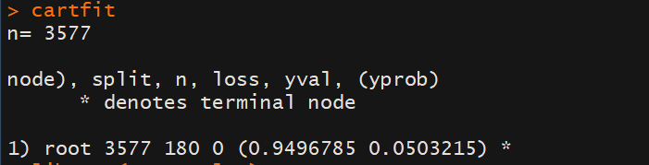
Tree based models
Normalized the numerical variables
CART model on original data (data not oversampled)

Slide 37
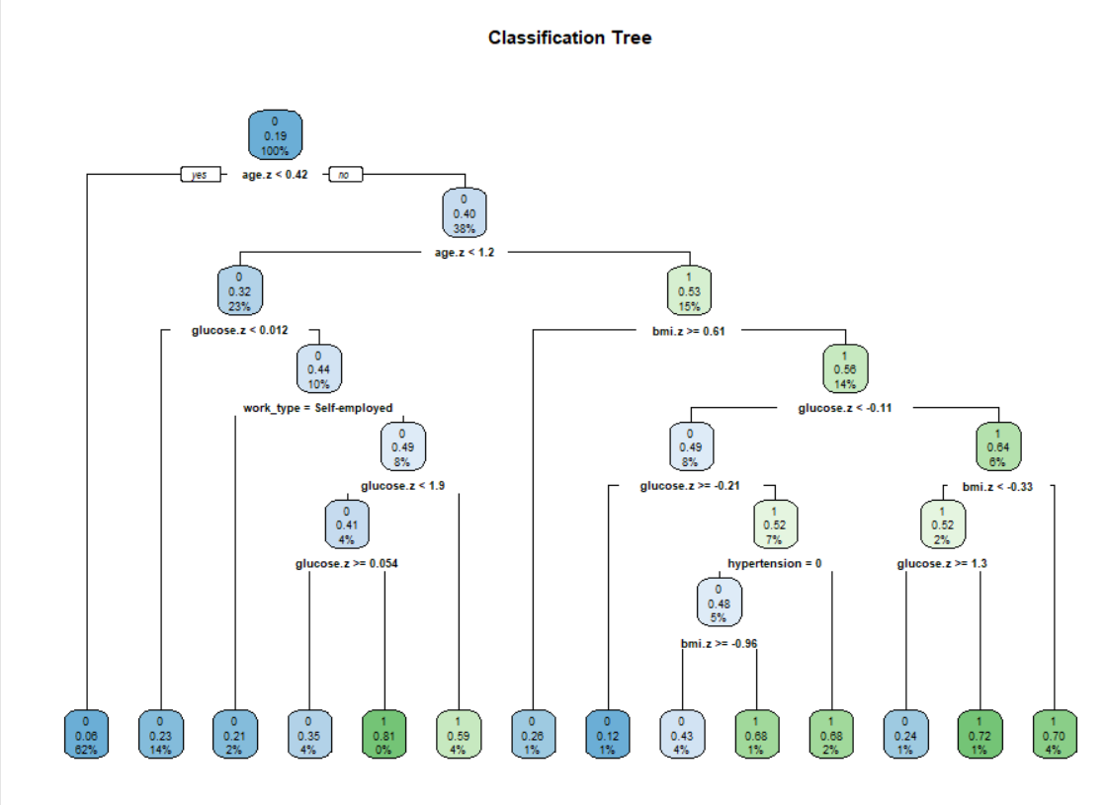
CART on the oversampled data

Slide 38

Notes:
As compared to the logistic regression model with cut-off 0.5, recall/sensitivity, precision and accuracy has increased, but so has FPR.

Slide 39

C5 tree on data not oversampled

Slide 40

C5 tree on oversampled data
The tree was big. The attributes used were

Slide 41

Notes:
Specificity has reduced a little, but f_score has increased significantly. Performs good enough on the test data. I tried to create a pruned tree, but for that accuracy was dropping to 0.3

Slide 42

RF on data not oversampled

Slide 43


Random Forest on oversampled data

Slide 44



Glucose, age, smoking status, and work type
All variables used
Removing Gender

Slide 45
Thank You

